Slide 1
Classification of Diabetic Retinopathy using Retinal Images
(Convolutional Neural Network with MATLAB + Fusion Techniques)
Kevin Setiawan - 25895710
Nabil Ahmed - 25364170
Supervised by Dr Muhammad Fermi Pasha

Slide 2
Introduction
Diabetes is one of the fastest growing disease in the world
Diabetic Retinopathy is one of the effects from people who suffer from long term diabetes.
Can cause mild to severe vision problem.

Slide 3
Overview
Now, there are more than 300 million individuals suffering from DR and it is predicted to increase to almost 550 million by 2030.
DR is a major challenge in several underdeveloped (India) or overpopulated nations (China).
Early DR diagnosis can prevent potential blindness.
DR classification is highly time consuming and requires experienced clinicians.

Slide 4
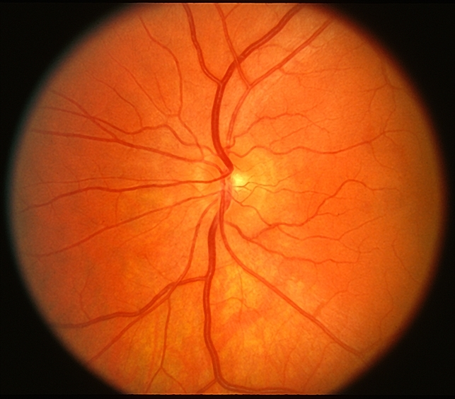
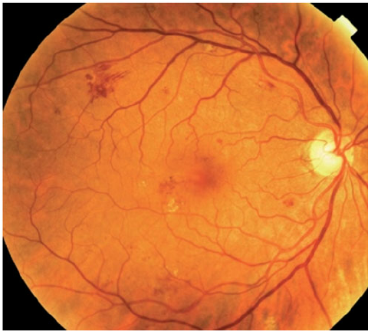
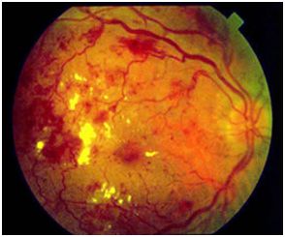
Diabetic Retinopathy
No DR
Mild DR
Severe DR
Our Dataset consist 654 images that already divided into 3 different class of DR

Slide 5
Key features of the product
Detect DR in constant time.
Eliminates the dire need of having an experienced clinician in times of emergency or in remote areas where they are not available.
You just need access to a computer with an internet connection or a trained architecture or a trained CNN architecture on DR saved into the computer memory.
Validates the CNN architectures used in other existing researches (Accuracy using the alexnet and googlenet) How does it validate? (Will be shown later)

Slide 6
Main Methodology
The Architectures used are:
AlexNet and GoogleNet.
Why? -Based on our research findings alexnet ranked with one of the highest accuracy in the field of detecting the level of DR. GoogleNet ranked in the top 5. -Resources were available to implement both of the above architectures.

Slide 7
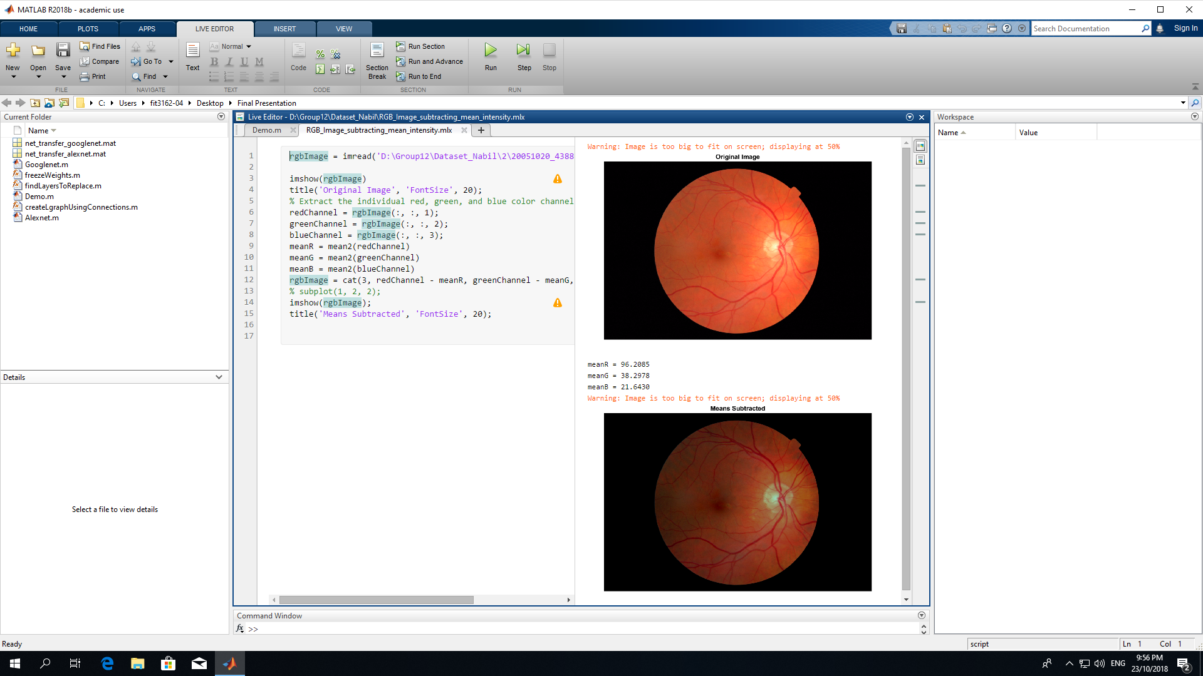
Pre-processing
The images have been resized according to the requirements of the CNN architecture.
Alexnet : 227 227 3 GoogLeNet : 224 224 3
Augmented Image
Random X reflection
Random X/Y translation

Slide 8
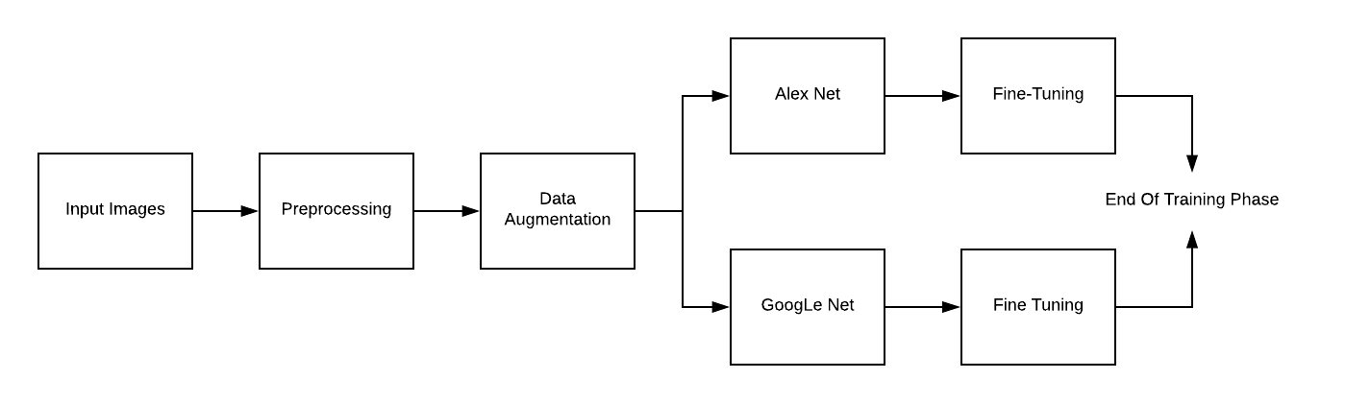
Training

Slide 9
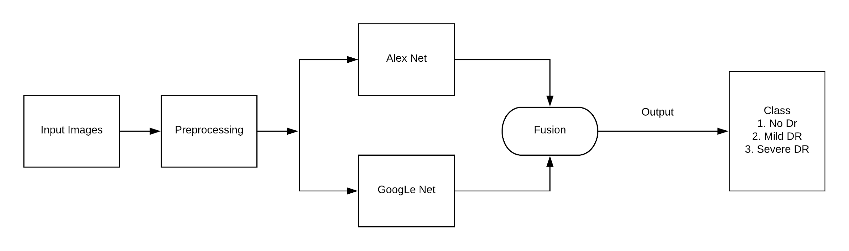
Testing

Slide 10
Fusion
Fusing the results from both the architectures by averaging the results from both the architectures and taking the max.
For example: Input = Image1 Output Using Alexnet: No DR: 0.5 Mild DR:0.3 Severe DR: 0.2 Output Using GoogleNet: No DR: 0.7 Mild DR:0.2 Severe DR: 0.1 After Fusing the Images : No DR: 0.6 Mild DR:0.25 Severe DR: 0.15
In this case the patient is classified as a No DR patient.

Slide 11
Range of Accuracy
Our accuracy ranges from (38 - 60) % for AlexNet.
Our accuracy ranges from (40 - 73) for GoogleNet.

Slide 12
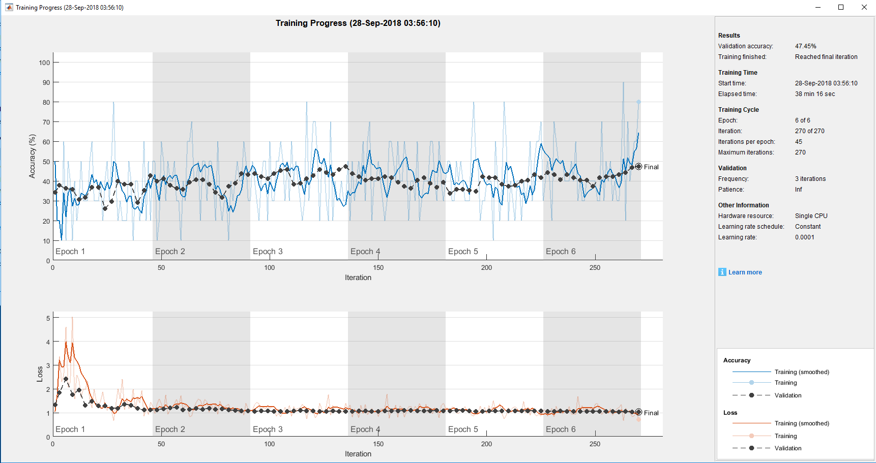
Example Result Using AlexNet

Slide 13
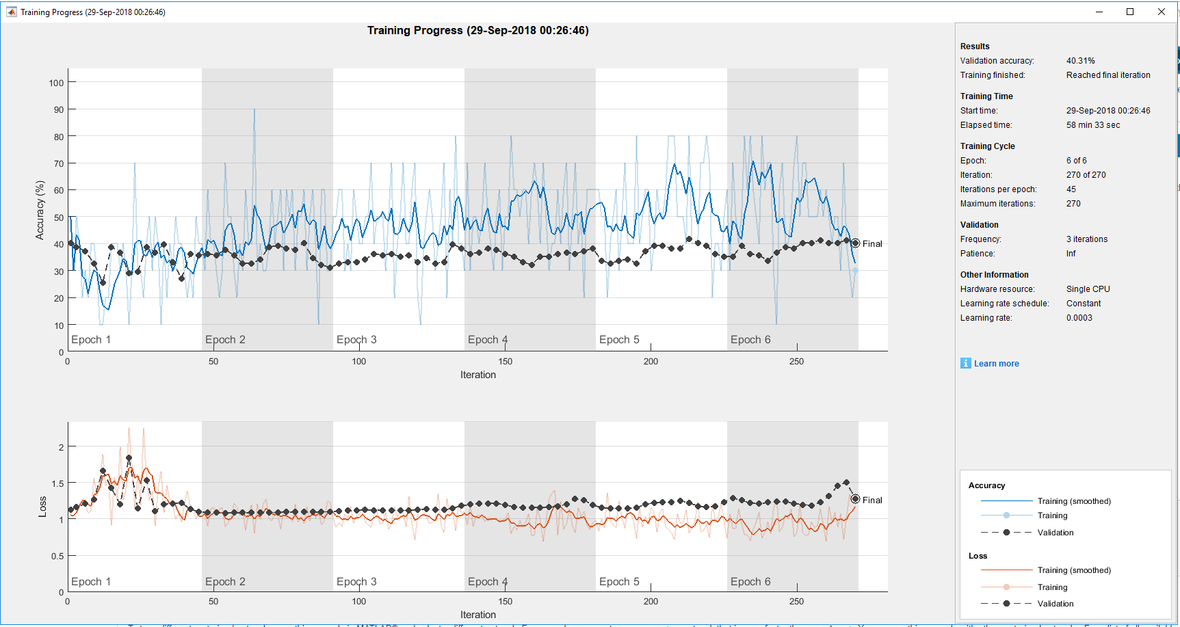
Example Result Using GoogleNet

Slide 14
Limitations
Our architecture cannot be used to detect DR level in real life scenarios.
Why? Because the validation accuracy is too less. For example: Input = Image1 Output Using Alexnet: No DR: 0.5 Mild DR:0.3 Severe DR: 0.2 Output Using GoogleNet: No DR: 0.7 Mild DR:0.2 Severe DR: 0.1 After Fusing the Images : No DR: 0.6 Mild DR:0.25 Severe DR: 0.15

Slide 15
Importance of our thesis
While testing, the probability that our input image will give the correct result is pretty high. We get this result by having a validation accuracy of only 40% for GoogleNet and 48% for Alexnet after training on the entire dataset.
This shows that existing researches that has a validation accuracy greater than 95%, their models are good enough to be used in real life scenarios.
Why our probability of getting correct result is high? One hypothesis is some of the classes learns better than the other classes.

Slide 16
Achievements
Approach to understanding a global issue and how by using our knowledge as computer scientists we can give back to the society.
Importance of solving an issue effectively in a particular domain/area.

Slide 17
Limitation
Time limitation
Bad time management
Limited Dataset
Knowledge about DR
Lack of MATLAB programming language skills
Shared VM

Slide 18
Lesson Learned
Time management
Working in group
How to handle risk
Mahara / Github version control
Use of advantages of each teammate and tackle disadvantages from each other

Slide 19
Conclusion
DR classification in real time
Our research shows that most of the other existing research is valid also can be used in real life scenario
Neural network can be used for other real life problem

Slide 20
Recommendation
Our Recommendation is to try other CNN architecture or other type of machine learning.
In the architecture, attempt to use different preprocessing images and fusion technique
Use more dataset when training the architecture

